Slide 1
Home learning ideas for Class 2!

Slide 2
Silky Soft Playdough
You will need
8 tbsp plain flour
2 tbsp table salt
60ml warm water
food colouring
1 tbsp vegetable oil
Method
1. Mix the flour and salt in a large bowl. In a separate bowl mix together the water, a few drops of food colouring and the oil.
2. Pour the coloured water into the flour mix and bring together with a spoon.
3. Dust a work surface with a little flour and turn out the dough. Knead together for a few minutes to form a smooth, pliable dough. If you want a more intense colour you can work in a few extra drops of food colouring.
4. Store in a plastic sandwich bag (squeeze out the air) in the fridge to keep it fresh

Slide 3
Sensory stories
Choosing a story
Try to find a story/book that has lots of repetition, actions and excitement to it.
In Class 2 we enjoy reading the same story over and over again so that we can really begin to understand it and anticipate what is going to happen next.
Recently we have been reading ‘We’re Going on a Bear Hunt’ and ‘A Perfect Job for an Elephant’.
Incorporate lots of actions, signs and maybe even props to create a fun sensory story!

Slide 4
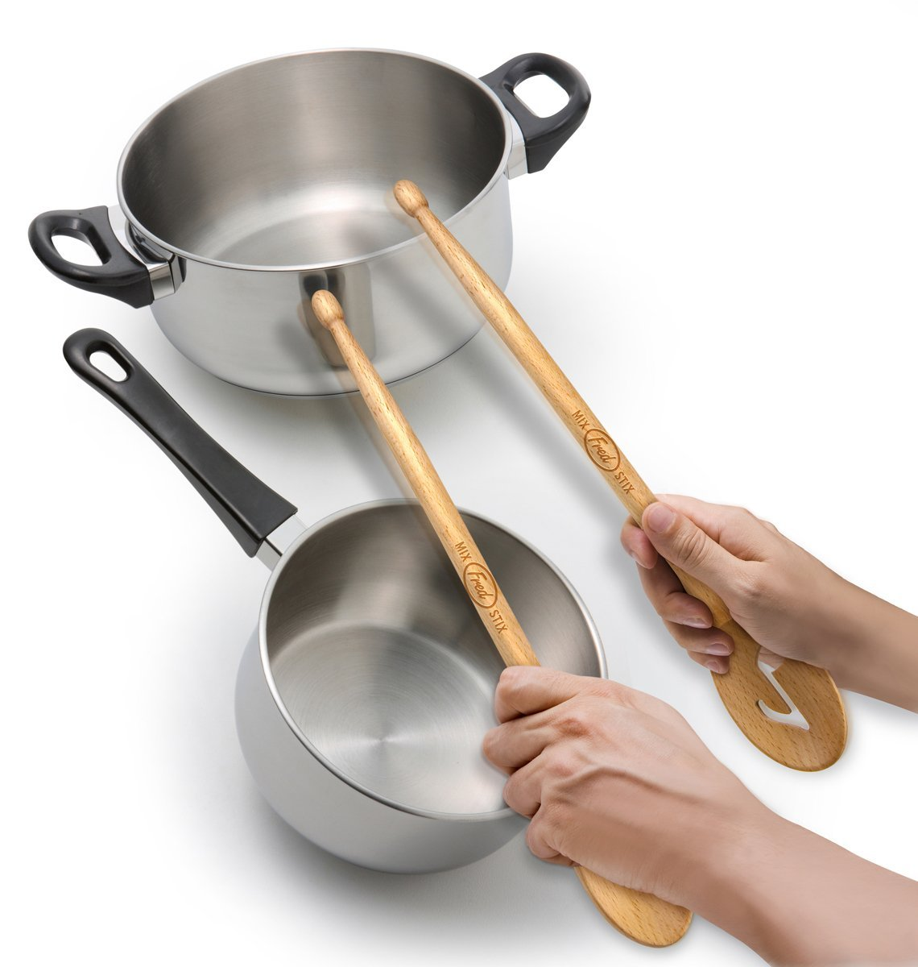
Sounds
Making noise and exploring sound
Explore everything around you!
Make fun with household utensils and objects, for example, learners can work on their fine motor skills by being presented with a range of different objects – can they hold and feel them? Which one is the loudest?
Can they hold one object and hit it onto another (hand over hand), for example, using sticks or wooden spoons and hitting them onto pans to make sounds?

Slide 5
Chocolate Easter egg nest cakes
As Easter is approaching we had some exciting recipes we were planning to do at school, here’s an easy one to follow at home.
Ingredients
225g/8oz plain chocolate, broken into pieces
2 tbsp golden syrup
50g/2oz butter
75g/3oz cornflakes
36 mini chocolate eggs
Method
Line a 12-hole fairy cake tin with paper cases.
Melt the chocolate, golden syrup and butter in a bowl set over a pan of gently simmering water, (do not let the base of the bowl touch the water). Stir the mixture until smooth.
Remove the bowl from the heat and gently stir in the cornflakes until all of the cereal is coated in the chocolate.
Divide the mixture between the paper cases and press 3 chocolate eggs into the centre of each nest. Chill in the fridge for 1 hour, or until completely set.

Slide 6
Movement
Stretching
Wherever possible spend lots of time moving, stretching, dancing and having fun!
At school we have lots of time using various pieces of equipment and on the mats. Whilst on the mats we enjoy playing instruments, exploring sensory objects and lights and playing games together.
We always begin our school day with a song by ‘Wham’ called ‘Wake me up before you go go’ as part of our morning routine. Please enjoy this at home and stretch each part of your body along with the song and with family.
You will be able to find the song on YouTube.
The link to song is:
https://www.youtube.com/watch?v=ELflyACZXQQ

Slide 7
Body Awareness
At home enjoy some fun interacting games with family members. A favourite in Class 2 is ‘Head Shoulders Knees and Toes’. This is another fun way we can work on our stretching.
Either independently or with support try....
Touch your nose
Touch your ears
Clap your hands
Touch or eye point to your feet
Make a noise
Touch the top of your head
Give someone a high five
Etc.

Slide 8
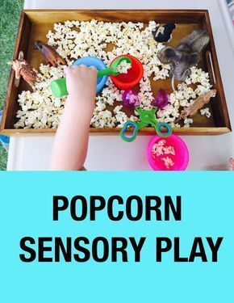
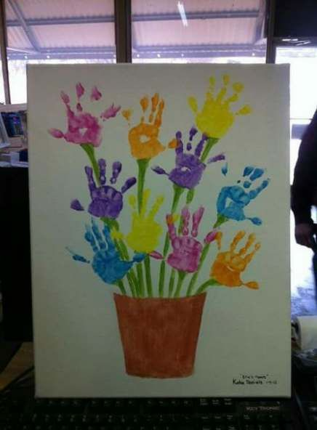
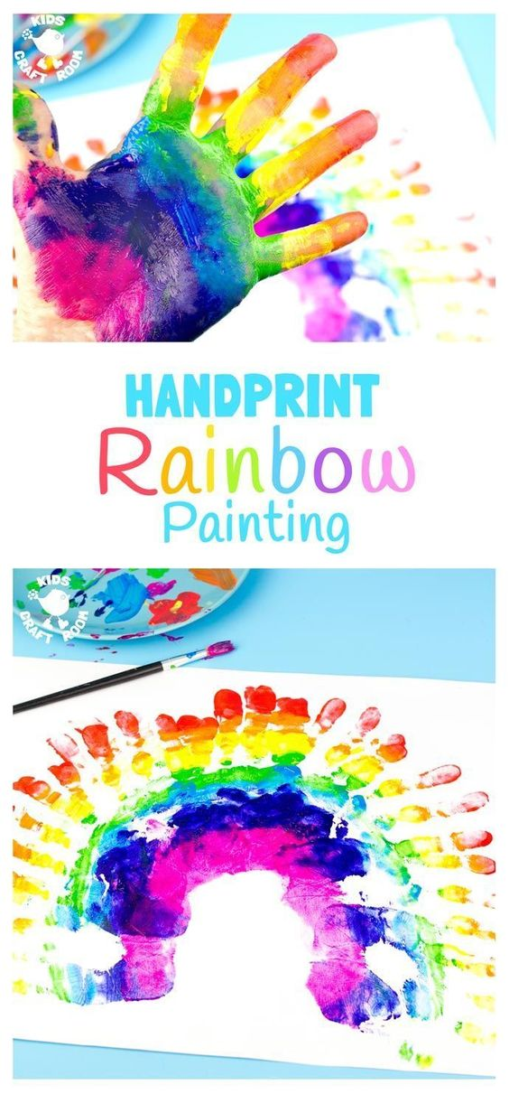
Arts & Crafts
Craft
In Class 2 we enjoy making different crafty things to be proud of. At home if you have access to craft materials, such as paint, paper, pens etc then any kind of craft work will be lots of fun with your family. Here are some ideas:

Slide 9
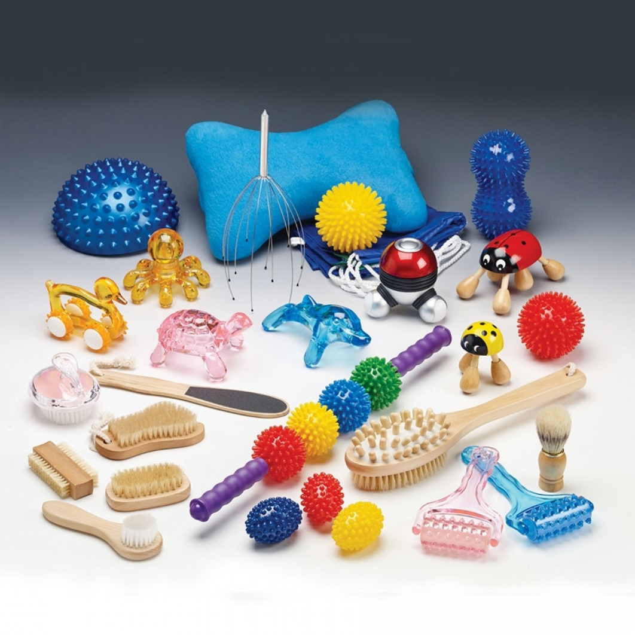
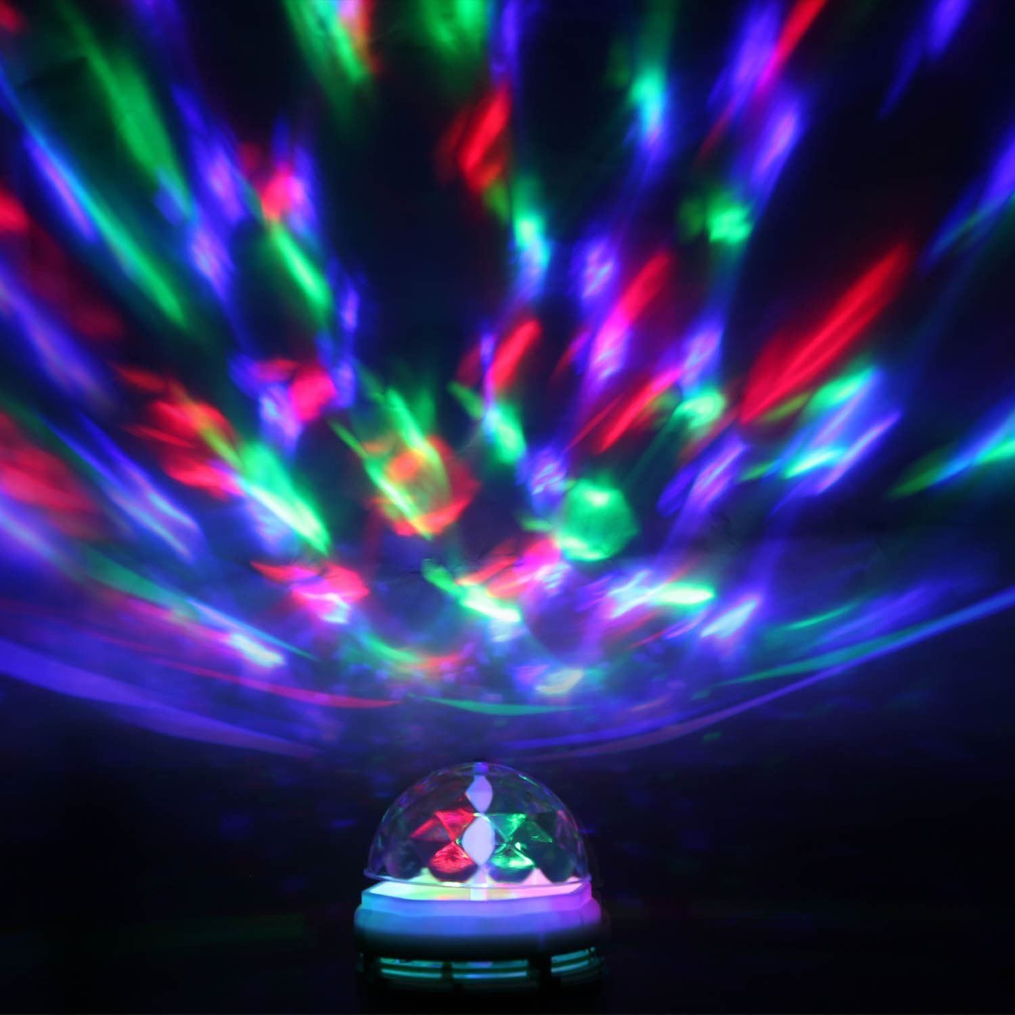
Relax!
At school we often enjoy some sensory massage time and this will be easy and simple to recreate at home.
Play some soothing/relaxing music, find some hand cream or moisturiser and then enjoy some quiet time.
If you have access to any sensory lights at home then this would be a great time to put them on and enjoy them in a dark space/room.

Slide 10
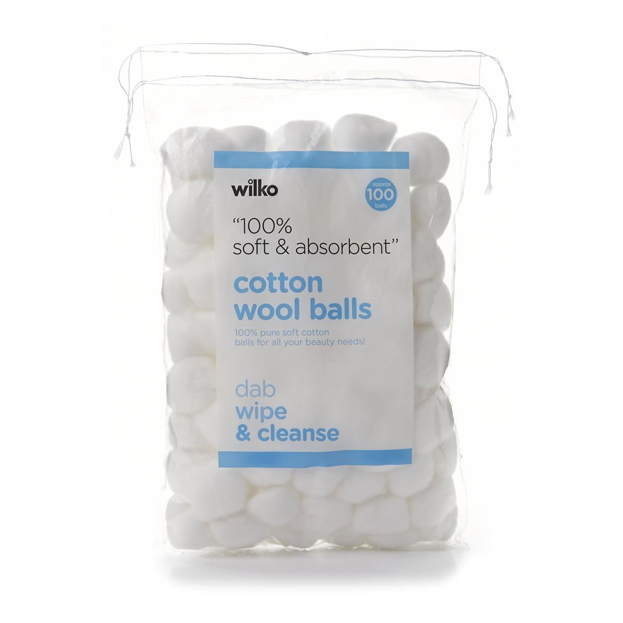
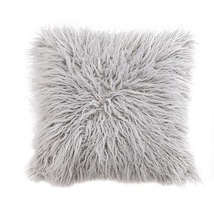
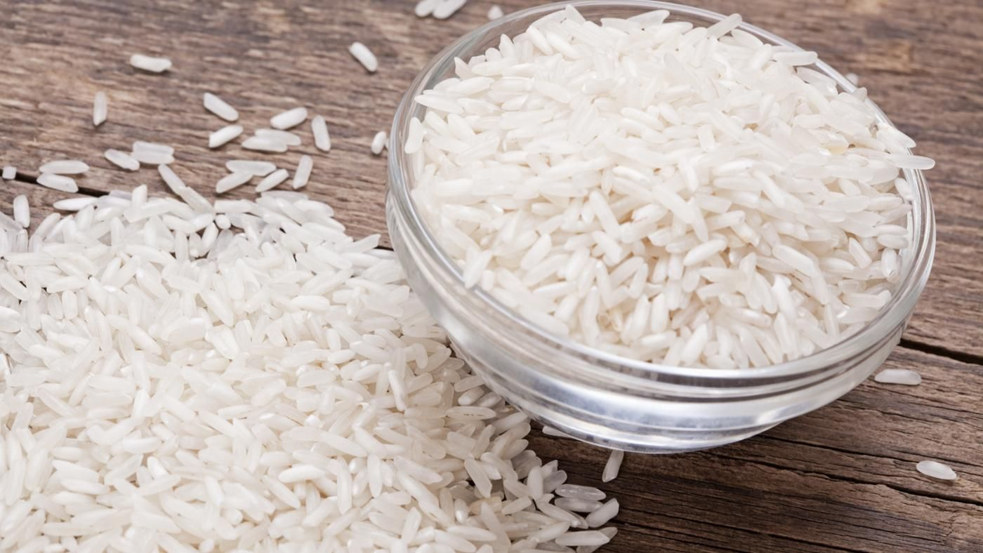
Sensory Exploration
Textures
In Class 2 we enjoy exploring lots of different and new textures as part of different activities.
Can you touch different things in your house?
Can you explore a tray/bowl filled with different textures with your hands or feet?
Can you choose which ones you like/dislike?

Slide 11
Outdoor learning
If you have access to an outdoor space and it is safe to do so then enjoy being outside, get some fresh air and explore!
Some ideas for things to do outside:
Collect things from the outdoors e.g. leaves, sticks, flowers etc. – can you use them to make a collage?
What can you see? Look all around your garden, what can you find?
What can you hear? Is it raining?
Can you feel wind on your face? Or is the sun shining and you can feel the warmth on you body?
Simply enjoy being outside and enjoy a walk!

Slide 12
Music
We love music activities/lessons in Class 2 so this would be a great way to have fun with all the family at home.
Do you have any instruments at home? If so, play them!
How much noise can you make?
Can you grasp onto an instrument?
Can you reach out for an instrument?
Can you independently or with support explore/play an instrument e.g. shake a shaker?

Slide 13
Topic – Colours, Colours All Around Us
To continue our termly topic here is the link to the sensory poem we have been reading every week:
https://slideplayer.com/slide/12822745/

Slide 14
Easter

Slide 15
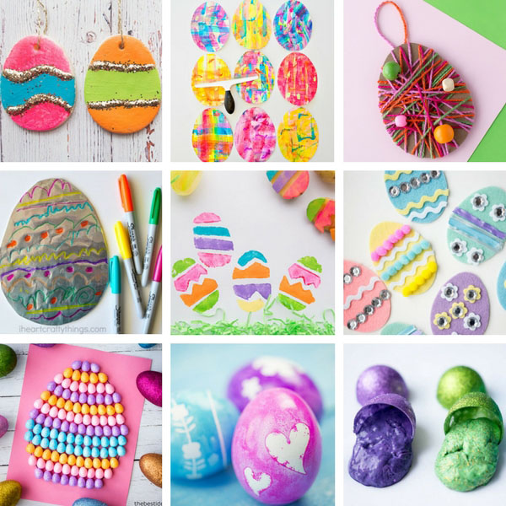
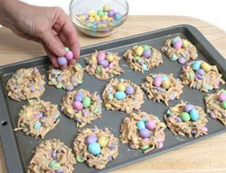
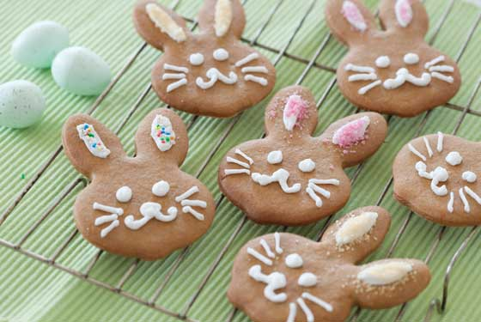
Easter
If we were at school we would have been doing lots of activities based around the celebration of Easter. If you wish to at home here are a couple of different things you could do with your family.
Easter baking/cooking – you will be able to find a range of different recipes to follow online to enjoy at home.
Easter crafts – some simple mark making, colouring, painting etc or make an Easter card.
Listening to/reading an Easter story.

